Slide 1
project Title: EVALUATION OF AGV CAPACITY IN A FLEXIBLE ‎MANUFACTURING SYSTEM
Abstract & Introduction
Model Description
Data Overview
Results & Conclusion
GROUP MEMBERS:
MOHAMED MEGAHED, HADEER ELMAHDY, CHUJUN HUANG, NICK GOLINA, SUMANTH AVUNURI

Slide 2
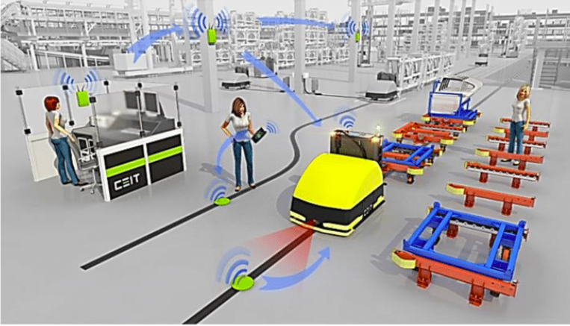
ABSTRACT & INTRODUCTION
The performance of manufacturing systems is one of the major concerns of the manufacturer. It helps companies adapt and survives in today’s competitive business environment.
Automated guided vehicles (AGVs) have now become commonplace in the manufacturing world. Manufacturers of ‎electronic goods and large automobile manufacturers are some well-known examples of industries that use AGVs in their ‎manufacturing operations.
The usage of AGVs in the US has increased signiﬁcantly in the last few years because of increasing ‎labor costs associated with human-operated material-handling systems (Heragu,S 2008). It is the case, however, that AGV systems ‎themselves tend to be very expensive. Even a single vehicle can cost several thousand dollars. On the other hand, even ‎one AGV can signiﬁcantly reduce the material-handling time and thereby increase throughput and reduce inventory.

Slide 3
DATA OVERVIEW
Incremental Time: Norm (15, 0.001) min
To study the effect of demand uncertainty, IAT is varied with a co- efficient of variance of 0.13, 0.26, 0.4, and 0.53 respectively.
Processing Time: Norm (15, 0.001) min
To check which machine has minimum impact, the processing time of machine are made to vary with a co-efficient of variance of 0.13, 0.26, 0.4, and 0.53 respectively.
No of AGVs:
To analyze the system performance with respect to number of AGVs, the number is increased from 1,2,3,4 and 5 respectively.
IAT: Norm (15, 8) min, PT: Norm (15, 8) min,
Load/Unload times are 1
AGV velocity | 20 meter/minute
Distance between each segment | 10 meter
Replication Length | 100000
Number of replication | 1
Warm up time | 500 minute

Slide 4
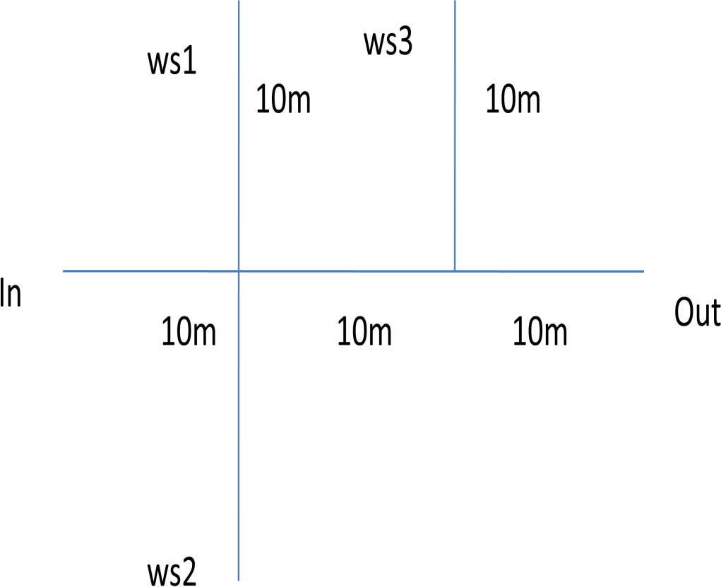
DATA OVERVIEW
ADVANCED TRANSFER/DISTANCE
Transporter1.Distance
SYSTEM LAYOUT
No | Beginning station | Ending station | Distance
1 | Arrive Dock | Station 1 | 20
2 | Station 1 | Station 2 | 20
3 | Station 2 | Station 3 | 30
4 | Station 3 | Exit shop | 20
5 | Arrive Dock | Station 2 | 20
6 | Arrive Dock | Station 3 | 30
7 | Arrive Dock | Exit shop | 30
8 | Station 1 | Station 3 | 30
9 | Station 1 | Exit shop | 30
10 | Station 2 | Exit shop | 30

Slide 5
First Hypothesis:
1- Effect of demand uncertainty Vs FMS performance
Hypothesis tested: As demand uncertainty increases, machine utilization decreases
MODEL DESCRIPTION
3 machines and one AGV.IAT Normal (15,0.001)with covariance 0.13,0.26,0.4,0.53 and processing time is kept as Normal(15,0.001) and corresponding machine utilization, output and throughput time for the three machines and AGV, are to be found out.

Slide 6
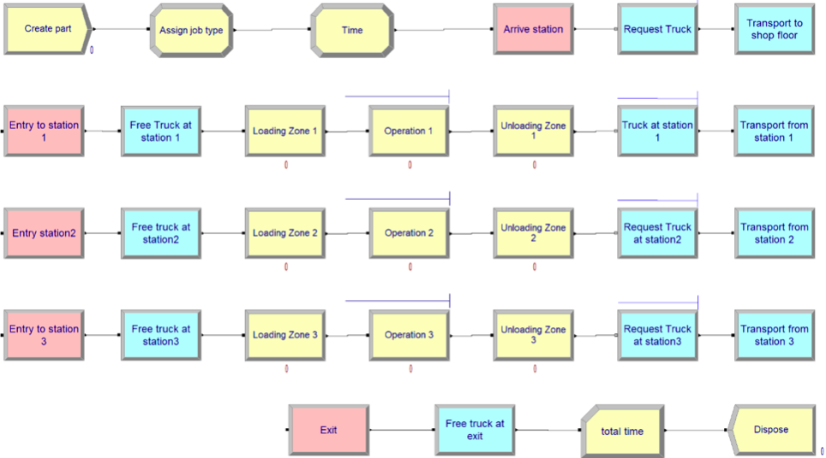
ARENA MODEL
Notes:
According to the given data the replication length is set as 1,00,000 minute and for a warmup period of 500 minute for 5 different IAT( Normal(15,001),Normal (15,2),Normal(15,4),Normal(15,6),Normal(15,8))

Slide 7
Model Verification:
Used below common verification methods:
Check Model for errors.
Set Max entities arrival to 1.
Checked model under extreme conditions (increased interarrival/service times.
Changed part type distribution to constant.

Slide 8
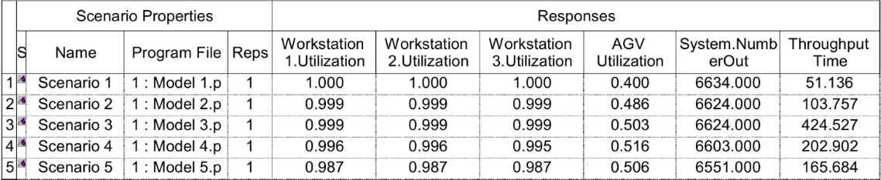
Process Analyzer Results
The utilizations, output in numbers and throughput time for the three machines and AGV are obtained as given in the table. From the results we can know that machine utilization should not have significant variation for same IATs. When IAT are changing from Normal(15,.001) to Normal (15,8) the machine utilization decreases, output decreases and throughput time increases till Scenario 3 and then decreases

Slide 9
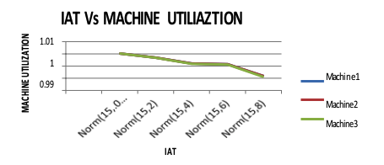
IAT Vs. Machines utilization
From the above graph it is understood that according to the changes in Inter arrival time ‎the machine utilization decreases

Slide 10
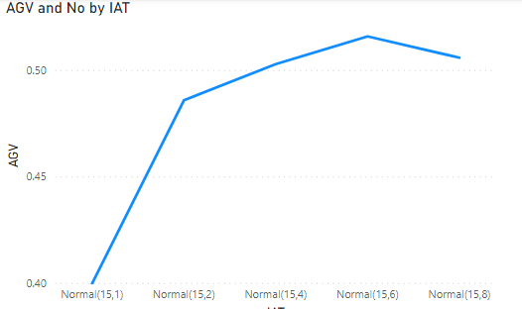
IAT vs AGV utilization
From the above graph change in AGV utilization is significantly small with ‎increase of IAT.‎

Slide 11
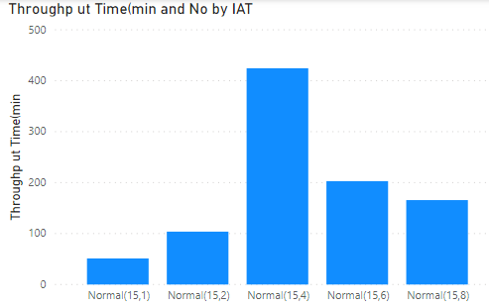
Inter arrival time vs Throughput Time
From the above graph it is observed that the throughput time increases with increase of IAT untill Norm(15,4) and then deceases again.

Slide 12
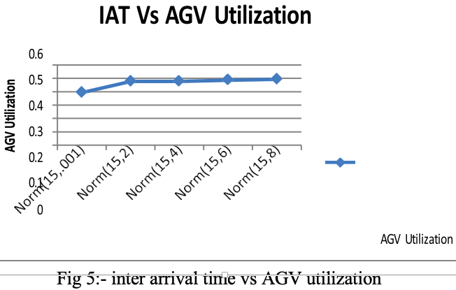
RESULT & CONCLUSION
Change in AGV utilization is significantly small with ‎increase of IAT.‎
From the above graph it is understood that according to the changes in Inter arrival time ‎the machine utilization decreases

Slide 13
Conclusion of 1 hypothesis:‎
From the above results it is found that machine utilization should not have ‎significant variation for same IATs. When IAT are changing from Normal(15,.001) to ‎Normal (15,8) the machine utilization decreases, output decreases and throughput time ‎increases. So, we can say the Hypothesis is accepted.‎

Slide 14
Second Hypothesis:
2. Effect of number of AGV’s on FMS performance
Hypothesis tested: increase in the number of AGVs increases the system performance initially and then decreases it.
MODEL DESCRIPTION
Model created in AREA based on the above procedure. Here in this model the number of transporters is initially set as one. The number of AGV varied to2, 3, 4, 5 and 6. To get variation in model performance the processing time is set as Norm (15, 8).

Slide 15
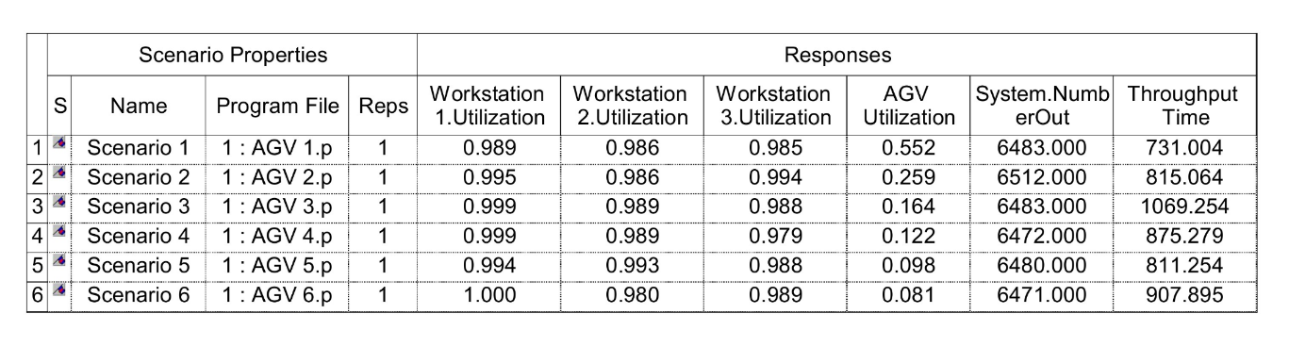
Process Analyzer Results
RESULT AND DISCUSSION
In the experiment the number of AGV is varied as 1, 2, 3, 4, 5 and 6. The utilization of the three machines M1, M2, M3, AGV utilization, output, throughput time are noted from the output sheets after running the simulation model.

Slide 16
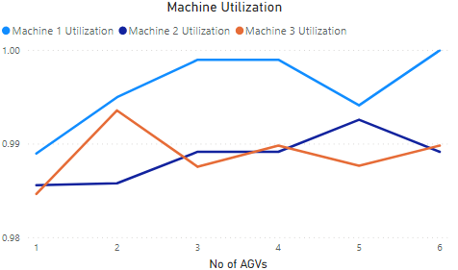
Number of AGV v/s Machine utilization
From above graph, machine utilization initially increases and shows decreasing trend with increase in number of AGV‘s. Machine M1, M2, M3 achieve the maximum utilization corresponding to 3, 4, 6no. of AGV‘s.

Slide 17
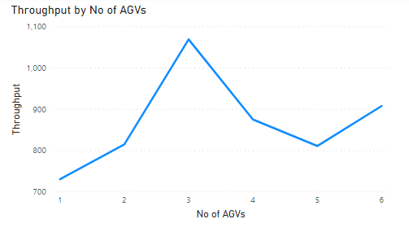
Number of AGV v/s Throughput utilization
Throughput time shows fluctuation with variation in number of AGV‘s, it initially increases , reaches a maximum value and then decreases. It again shows positive trend with further increase in number of AGV‘s. AGV utilization is maximum at 4 and 6 no. of AGV‘s.

Slide 18
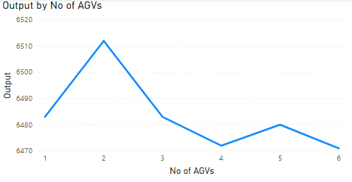
Number of AGV v/s Output
The output varies slightly with the increase in number of AGV‘s. The trend is to increase initially, then to decrease. The maximum output corresponds to 2 AGV‘s.

Slide 19
When IAT are changing from Normal(15,.001) to ‎Normal (15,8) the machine utilization decreases, output decreases and throughput time ‎increases. So, we can say the Hypothesis is accepted.
From the simulation it can be seen that the increase in performance of the system is small compared to the decrease in AGV utilization with respect to the variation in no. of AGV‘s.
The AGV utilization continually shows a downward trend.
The test considers the AGV‘s without specifying the route or variation in speed.
The loading/unloading time assumed to be zero. But practical situations may be different from the assumed.
As the uncertainties in processing time and inter arrival time increases, the effect of no. of AGV on utilization of resources also increase.
To account that effect here both the time are considered as Norm (15, 8) instead of Norm (15, .001) in other experiments.
‎
CONCLUSION of 2 hypothesis

Slide 20
THANK YOU!

